Slide 1
Person Detection
from a
Top-View Perspective
Mameli Marco
Paolanti Marina
Pazzaglia Giulia
Frontoni Emanuele
Baldascino Giovanni - 1097405
Squarcella Loisi - 1096539

Slide 2
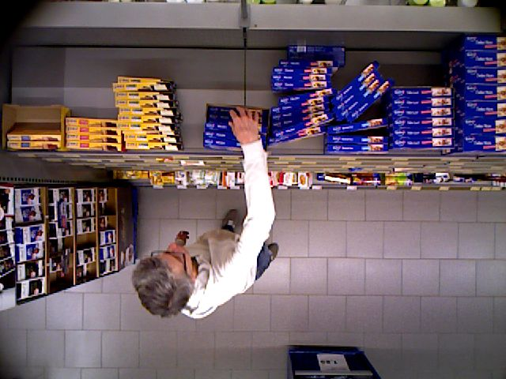
INTRODUCTION
Person Detection is performed from a Top-View Perspective by using most recent object detection frameworks.
The aim is to build an efficient model to detect the people in the scene.
This framework is evaluated on a real-world scenario which is a retail environment.

Slide 3
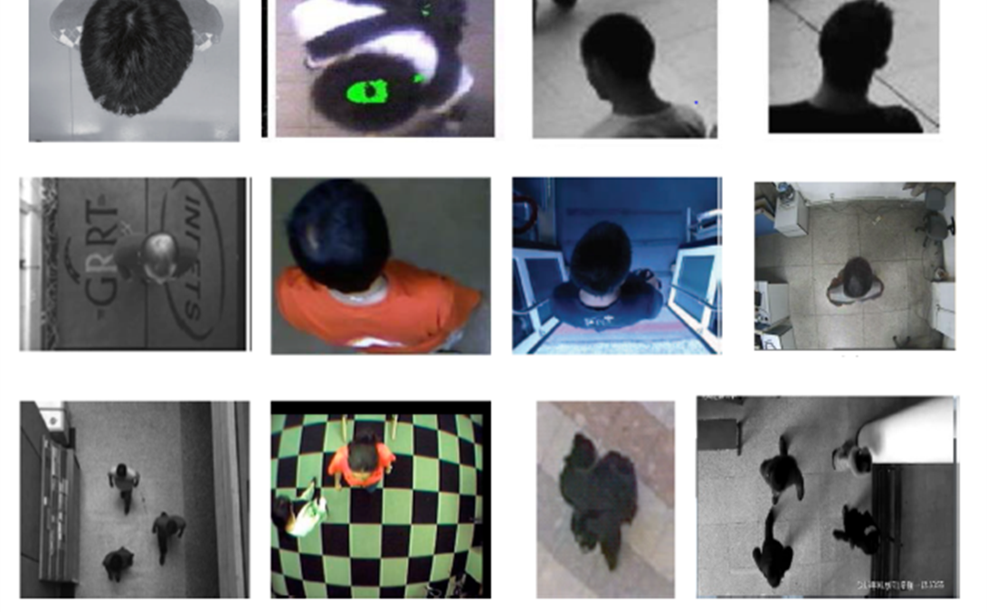
INTRODUCTION
MAIN STEPS:
Definition of the Region of Interest (ROI);
People localization.

Slide 4
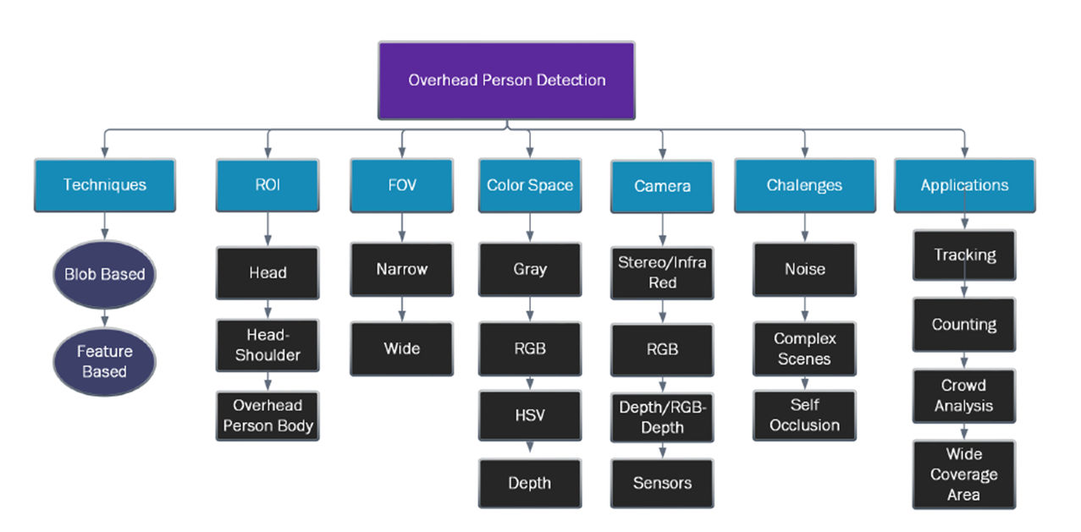
STATE OF ART – Person Detection

Slide 5
STATE OF ART – Person Detection

Slide 6
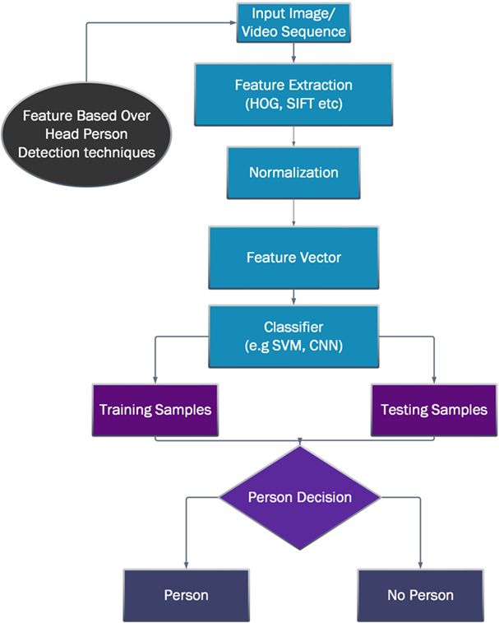
STATE OF ART – Feature based Techniques
These Feature based Techniques operate on features extracted from overhead view videos and images.
The extracted features contain shape, color, texture, etc.… The images are often divided into samples for training and testing.

Slide 7
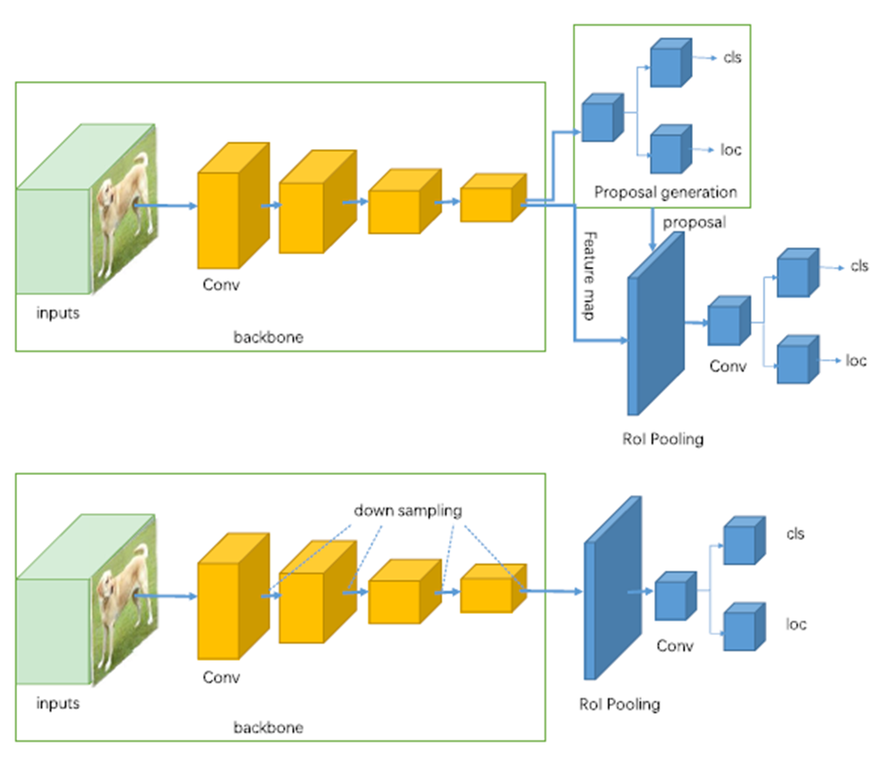
STATE OF ART – Feature based Techniques
Two-stage Detectors (R-CNN, Faster R-CNN, etc..) use a Region Proposal Network to generate regions of interests.

Slide 8
STATE OF ART – Feature based Techniques
Two-stage Detectors (R-CNN, Faster R-CNN, etc..) use a Region Proposal Network to generate regions of interests.
One-stage Detectors (YOLO, SSD, etc..) treat object detection as a simple regression problem.

Slide 9
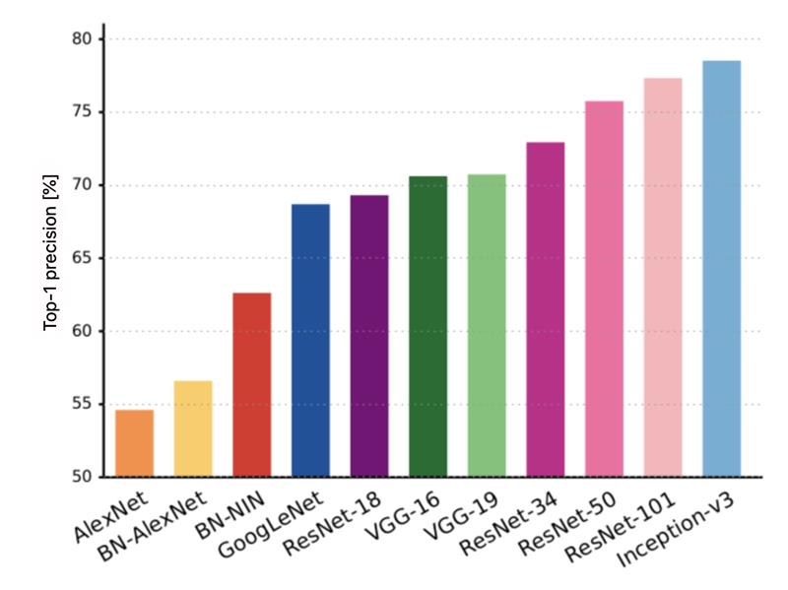
STATE OF ART – Feature extraction architectures

Slide 10
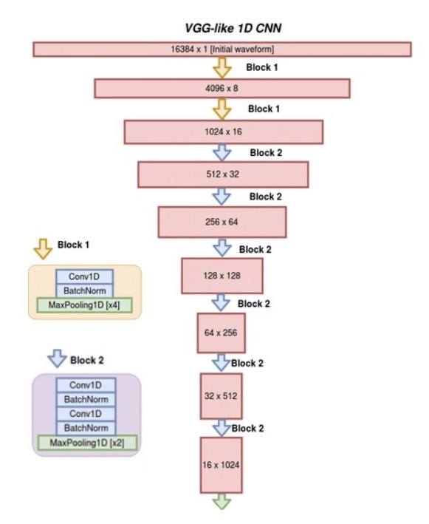
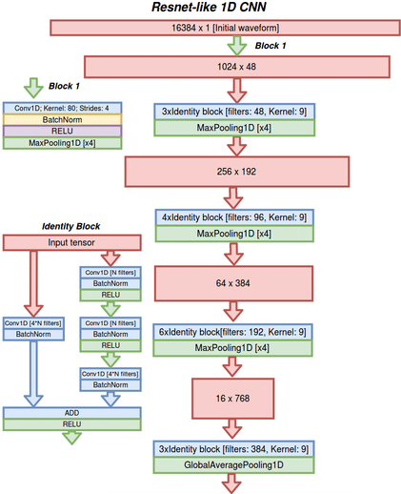
STATE OF ART – Feature extraction architectures

Slide 11
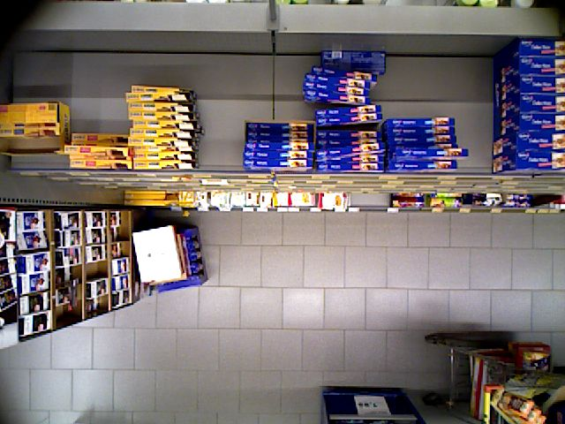

MATERIALS AND METHODS – Data Collection
The provided Dataset comes from video frames recorded by different cameras from a top-view, within a real environment: a supermarket.
These 30.000 images needed a skim because some did not contain people.

Slide 12
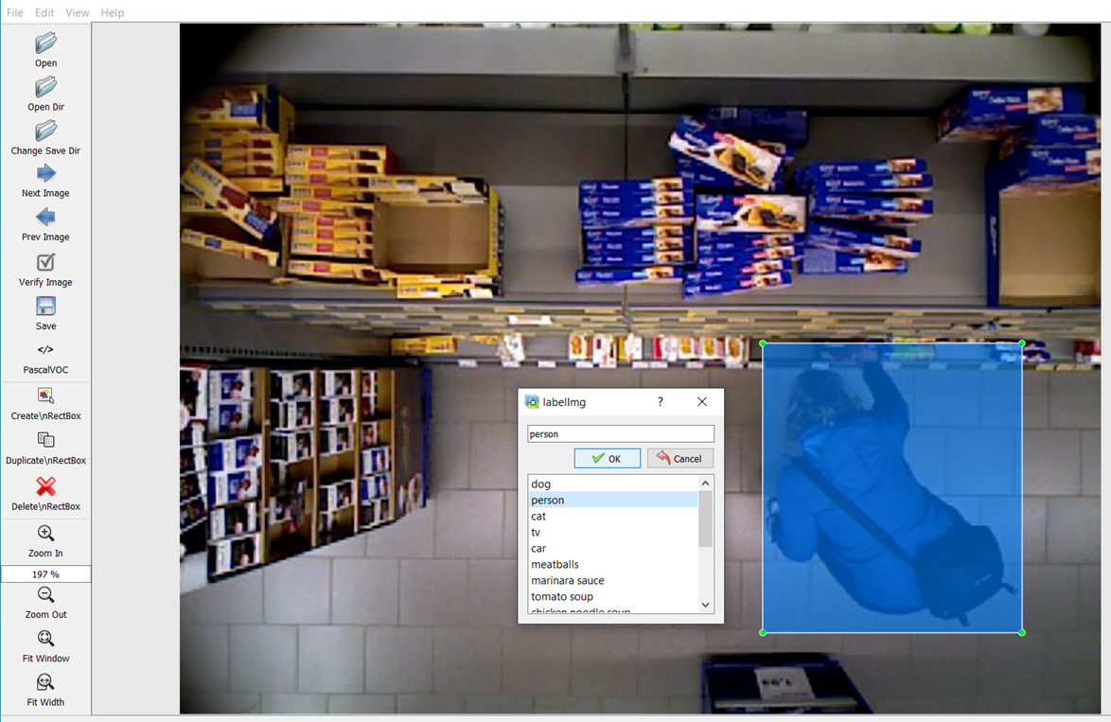
MATERIALS AND METHODS – Labelling
Dataset annotation using LabelImg. LabelImg is a graphical image annotation tool.
About 17.000 images divided into:
Testing set → 30%
Training set → 70%
Validation set → 30% of training set

Slide 13
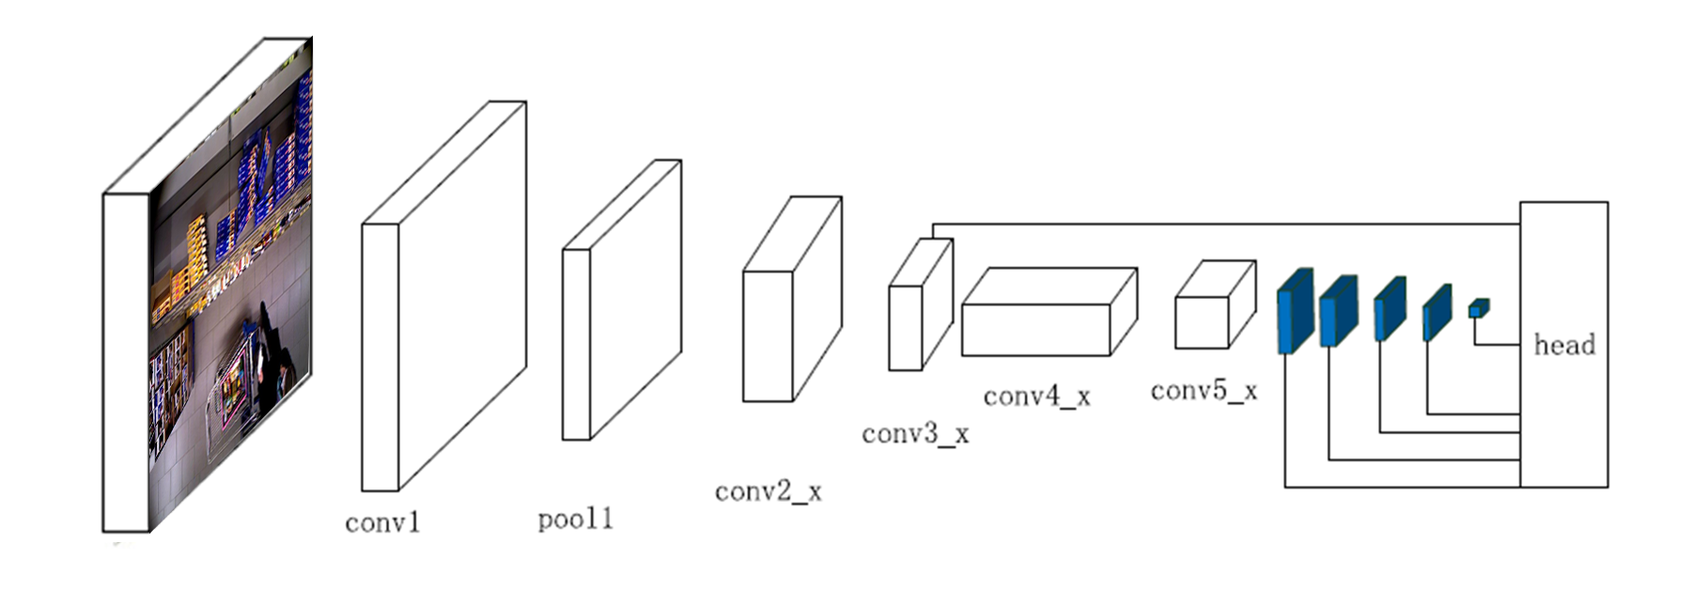
MATERIALS AND METHODS – Single-shot Detector
SSD (Single-shot Detector) discretizes the output space of bounding boxes into a set of default boxes over different aspect ratios and scales per feature map location.
In SSD the prediction layer is acting on fused features of different levels. Head module consists of a series of convolutional layers followed by several classification layers and localization layers.
[Wei Liu et al, 2016] Present a method for detecting objects in images using a single deep neural network. The approach, named SSD, discretizes the output space of bounding boxes into a set of default boxes. over different aspect ratios and scales feature map location.

Slide 14
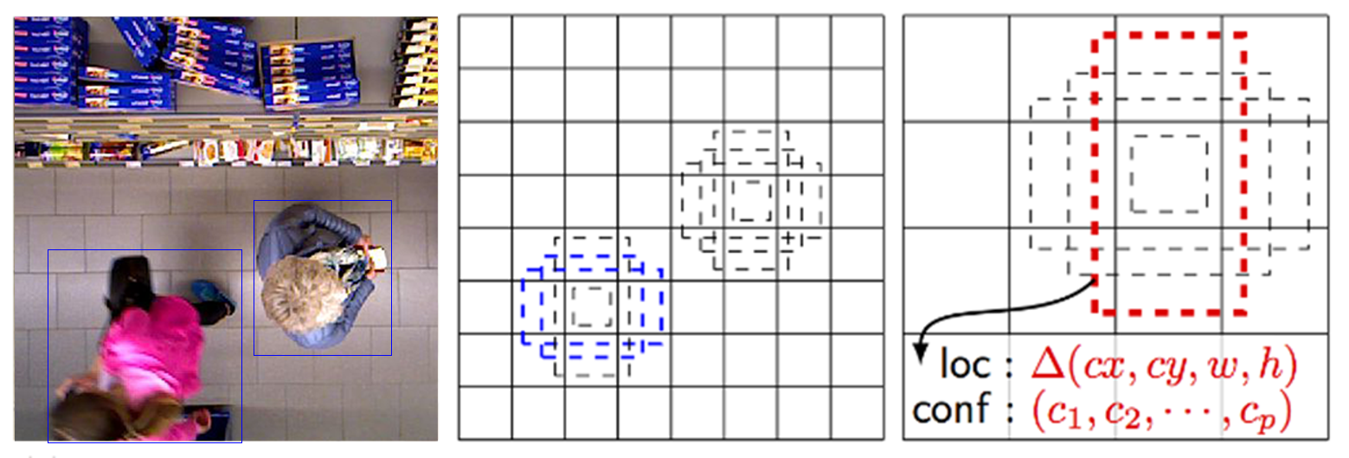
MATERIALS AND METHODS – Single-shot Detector
Each prediction is composed of:
Bounding box with shape offset (∆cx, ∆cy, w and h);
Confidences for all object categories or all the classes.

Slide 15
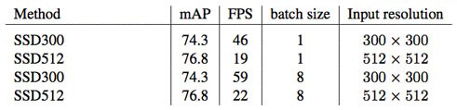
MATERIALS AND METHODS – Settings
Three types of Single-shot Detectors were used: SSD300, SSD512 and SSD7. The architecture of the first two is almost the same (9 and 10 layers respectively) while the SSD7 provides a simplified approach (7 layers).
The default backbone was based on VGG16, then replaced with ResNet50.
Furthermore, a subsequent approach was fine tuning starting from a pre-trained model.

Slide 16
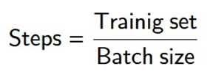
MATERIALS AND METHODS – Settings
Three types of Single-shot Detectors were used: SSD300, SSD512 and SSD7. The architecture of the first two is almost the same (9 and 10 layers respectively) while the SSD7 provides a simplified approach (7 layers).
 |  | Batch size | Steps per epoch
VGG16 | SSD300 | 32 | 260
 | SSD512 | 16 | 520
ResNet50 | SSD300 | 32 | 260
 | SSD512 | 12 | 690
Epochs = 40
Learning rate = 0,001

Slide 17
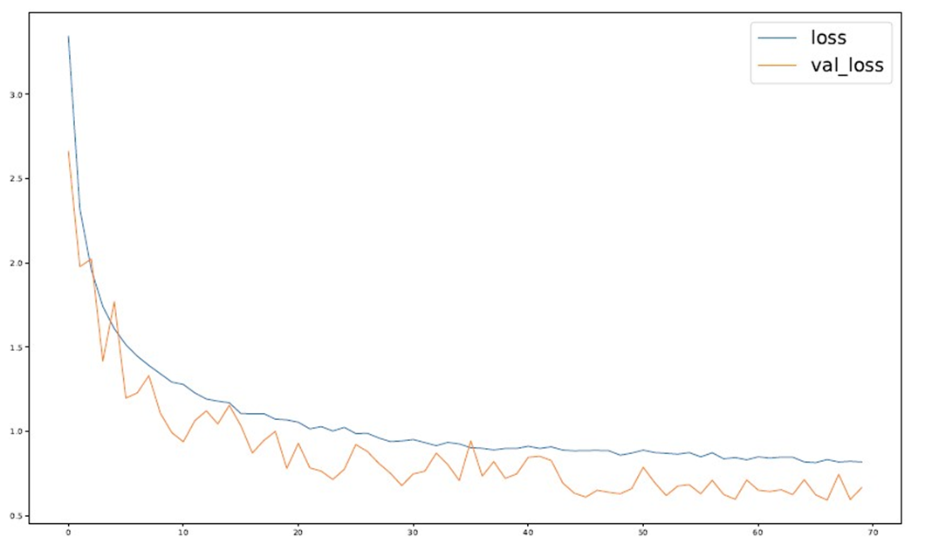
MATERIALS AND METHODS – Settings
Three types of Single-shot Detectors were used: SSD300, SSD512 and SSD7. The architecture of the first two is almost the same (9 and 10 layers respectively) while the SSD7 provides a simplified approach (7 layers).
SSD7
Epochs = 70
Learning rate = 0,001

Slide 18
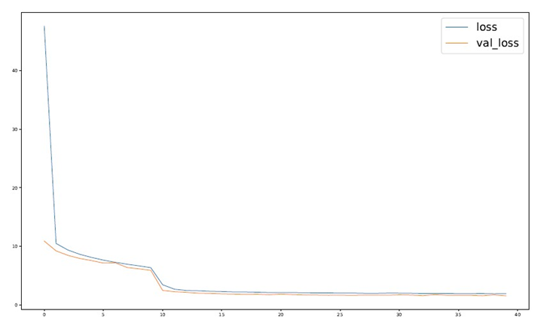
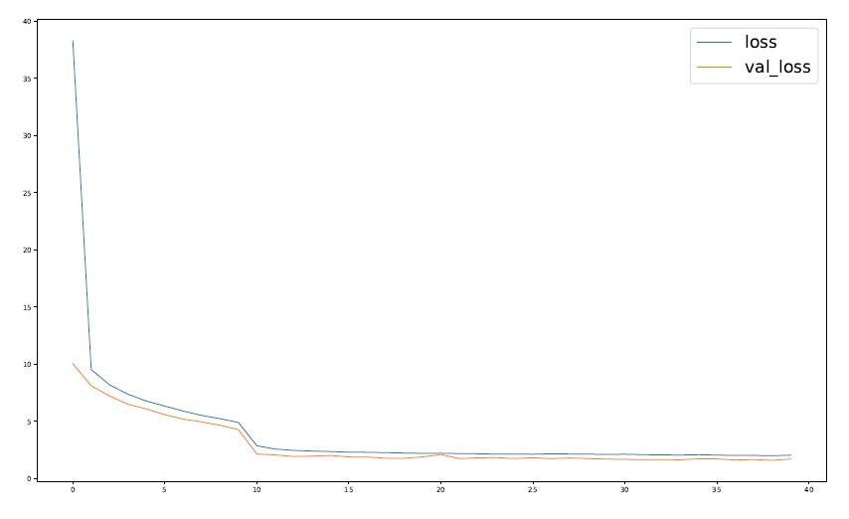
MATERIALS AND METHODS – Settings
SSD300
SSD512
VGG16

Slide 19
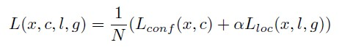
MATERIALS AND METHODS – Loss Function
The Loss function consists of two terms: L_{conf} and L_{loc} where N is the matched default boxes.
L_{loc} is the Localization Loss which is the smooth L1 loss between the predicted box (l) and the ground-truth box (g) parameters. L_{conf} is the Confidence Loss which is the softmax loss over confidences (c).

Slide 20
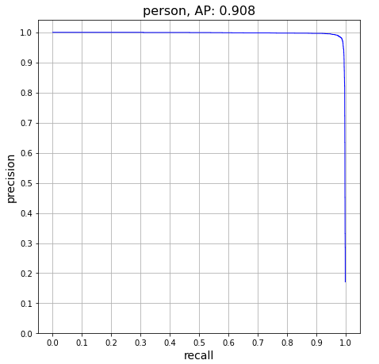
RESULTS AND DISCUSSIONS
The metrics used for the evaluation are AP (Average Precision), Recall, F1 Score and IoU (Intersection over Union).
SSD300 | AP | Recall | F1 Score | IoU
VGG16 | 0,908 | 0,818 | 0,861 | 0,879
ResNet50 | 0,909 | 0,618 | 0,736 | 0,842
SSD512 | AP | Recall | F1 Score | IoU
VGG16 | 0,908 | 0,912 | 0,910 | 0,801
ResNet50 | 0,909 | 0,872 | 0,890 | 0,846
SSD512 (VGG16)

Slide 21
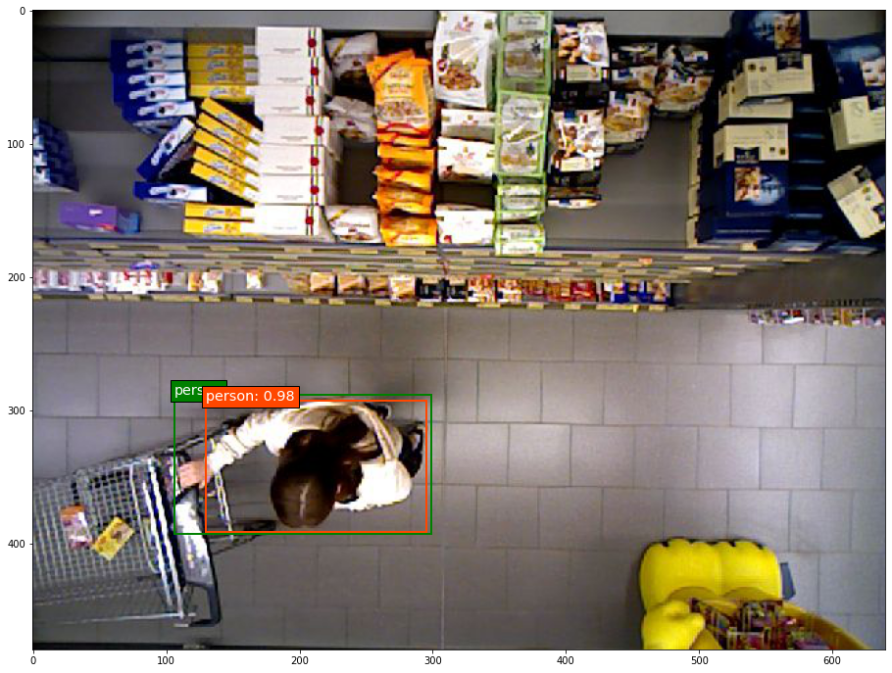
RESULTS AND DISCUSSIONS
The metrics used for the evaluation are AP (Average Precision), Recall, F1 Score and IoU (Intersection over Union).
SSD300 | AP | Recall | F1 Score | IoU
VGG16 | 0,908 | 0,818 | 0,861 | 0,879
ResNet50 | 0,909 | 0,618 | 0,736 | 0,842
SSD512 | AP | Recall | F1 Score | IoU
VGG16 | 0,908 | 0,912 | 0,910 | 0,801
ResNet50 | 0,909 | 0,872 | 0,890 | 0,846
SSD512 (VGG16)

Slide 22
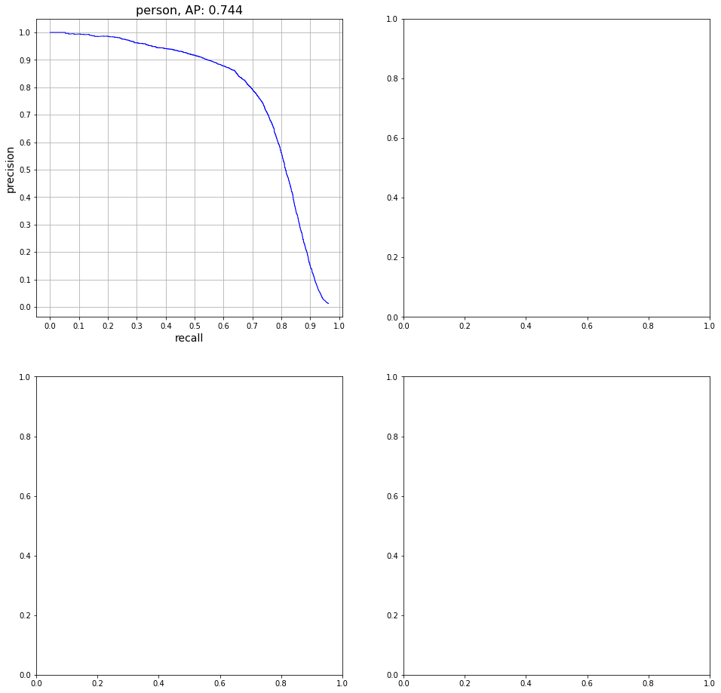
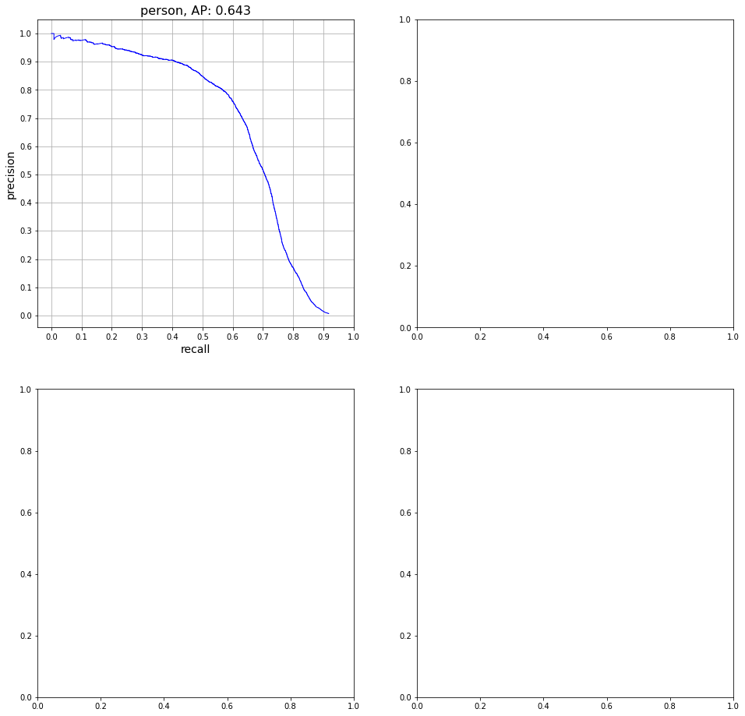
RESULTS AND DISCUSSIONS
The SSD300 and SSD512 presented weights related to models already trained on the Pascal VOC 07 + 12 dataset; a fine tuning of the weights was made to go from 20 classes to the only <person> class.
SSD512
SSD300

Slide 23
RESULTS AND DISCUSSIONS
The SSD300 and SSD512 presented weights related to models already trained on the Pascal VOC 07 + 12 dataset; a fine tuning of the weights was made to go from 20 classes to the only <person> class.
FINE-TUNE | SSD300 | SSD512
AP | 0,643 | 0,744
Recall | 0,887 | 0,934
F1 Score | 0,746 | 0,828
IoU | 0,712 | 0,885
SSD512
SSD300

Slide 24
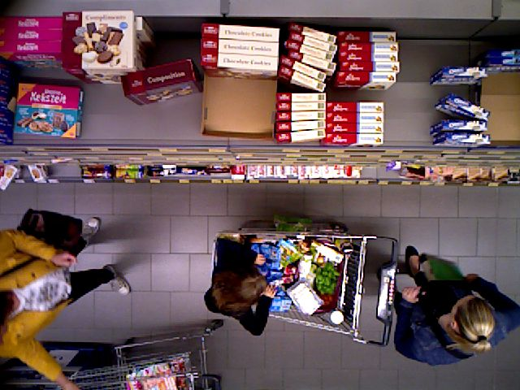
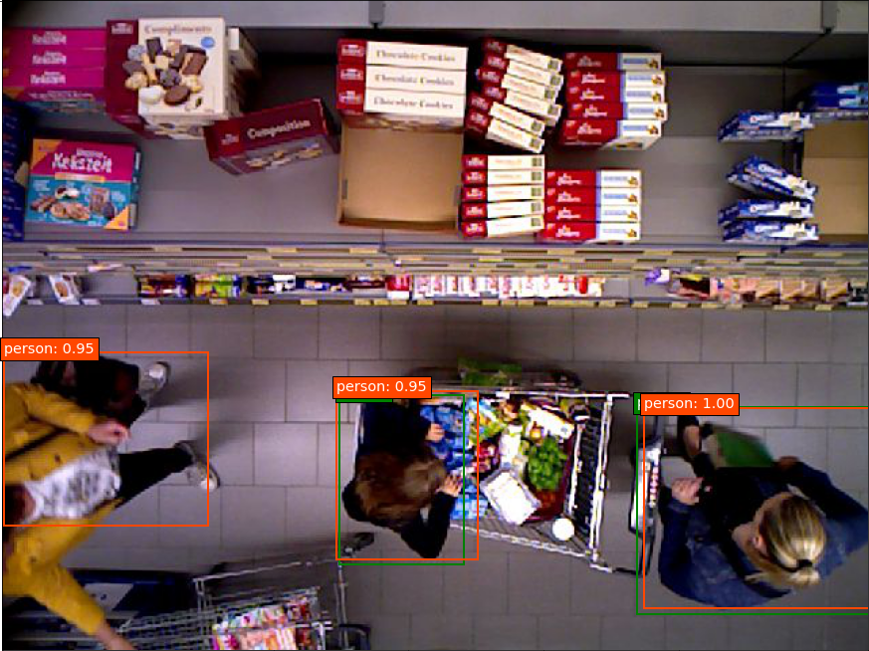
CONCLUSION AND FUTURE WORKS
Labelling the Dataset (~17.000);
Replacement of VGG16 with ResNet50;
Training from scratch and fine-tuning;
Average Precision not less than 90%.
The proposed approach, i.e. replacing the feature extractor, proved to be excellent to solve the detection problem. The best architecture remains the SSD512 with the VGG16.

Slide 25
CONCLUSION AND FUTURE WORKS
Changing the feature extractor with other architectures ResNet-like, for example DenseNet;
Changing the type of feature extractor, i.e. Feature Pyramid Networks (FPN)

Slide 26
REFERENCES
[1] Misbah Ahmad, Imran Ahmed, Kaleem Ullah, Iqbal khan, Ayesha Khattak, Awais Adnan, "Person Detection from Overhead View: A Survey".
[2] Wei Liu, Dragomir Anguelov, Dumitru Erhan, Christian Szegedy, Scott Reed, Cheng-Yang Fu, Alexander C. Berg, "SSD: Single Shot MultiBox Detector".
[3] Zhengxia Zou, Zhenwei Shi,Member, IEEE, Yuhong Guo, and Jieping Ye,Senior Member, "Object Detection in 20 Years: A Survey," IEEE.
[4] L. Jiao et al., "A Survey of Deep Learning-Based Object Detection," in IEEE Access, 2019, vol. 7, pp. 128837-128868.
[5] R. Girshick, J. Donahue, T. Darrell, and J. Malik, "Rich feature hierarchies for accurate object detection and semantic segmentation," in Proceedings of the IEEE conference on computer vision and pattern recognition, 2014, pp.580-587.
[6] R. Girshick, J. Donahue, T. Darrell, and J. Malik, "Region based convolution with deep convolutional neural networks," in Advances in neural information processing systems, 2012, pp. 1097-1105.

Slide 27
“Some people call it Artificial Intelligence but the reality is, this technology will enhance us. So, instead of Artificial Intelligence I think we will Augment our Intelligence”
Ginni Rometty, President & CEO of IBM

